Slide 1

IoT SAFE
Researcher: Mohammad Hossein Shafiee

Slide 2
Introduction
Key rotation is a vital process in ensuring the security of IoT devices and communications. In IoT SAFE, it plays a crucial role in protecting data by regularly updating cryptographic keys. This presentation covers how HKDF (HMAC-based Key Derivation Function) and AES (Advanced Encryption Standard) are used for secure key management. HKDF helps derive new keys from a master key, ensuring continued security, while AES is used for encrypting sensitive data. Together, these methods enhance the overall security and scalability of IoT systems.

Slide 3
Key Rotation
Over-the-Air (OTA) Updates
  GSMA specifications ensure secure channels (e.g., HTTPS or dedicated SIM OTA protocols like SCP80) for sending key updates.
  Keys stored in the SIM are updated via secure OTA mechanisms.
Key Derivation Mechanism
  IoT SAFE supports key derivation using a master key stored in the SIM. Instead of transmitting new keys over the air, new keys are derived from the master key and additional parameters (e.g., device ID, timestamp).
Pre-Provisioned Keys with Validity Periods
  Some SIM cards are pre-provisioned with multiple keys that are valid for specific periods. When one key expires, the SIM switches to the next key automatically.

Slide 4
Pre-Provisioned Keys
Number of Pre-Provisioned Keys.
Key Validity Period.
Generate Master Key.
  It must be generated using a cryptographically secure random number generator (CSPRNG).
  Length: 128 bits to 256 bits.
Derive Session and Authentication Keys.
Write Generated Keys on SIM.

Slide 5
Key Derivation Mechanism
Key Validity Period.
Master Key Storage.
Session Key Generation Using HKDF.
Use This Session Key to Encrypt Data.

Slide 6
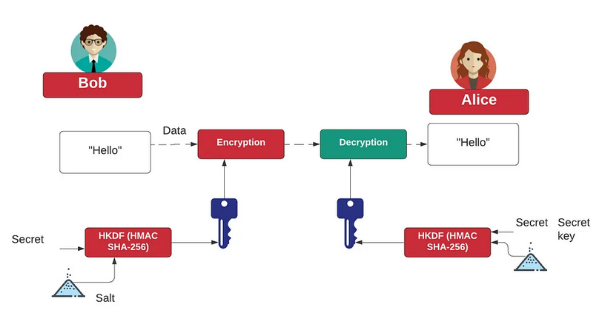
HKDF (HMAC-based Extract-and-Expand Key Derivation Function)
HMAC-based Extract-and-Expand Key Derivation Function (HKDF) is a method used to derive keys from a source of initial key material. It is designed to split, expand, or transform a given key into several additional cryptographic keys, each suitable for specific cryptographic operations. HKDF is widely used in protocols like TLS and various other security systems.

Slide 7


HKDF Phases
Extract Phase:
  Purpose: This phase extracts randomness from the initial key material to produce a fixed-length pseudorandom key.
  Method: Uses a Hash-based Message Authentication Code (HMAC) to process the initial keying material together with an optional salt (a non-secret random value).
  Output: A pseudorandom key (PRK), which can then be used in the expand phase.
  PRK is the pseudorandom key.
  HMAC is the HMAC function using a chosen hash algorithm (e.g., SHA-256).
  Salt is an optional but highly recommended random value.
  IKM is the initial key material.
Expand Phase:
  Purpose: Expands the pseudorandom key into multiple cryptographic keys.
  Method: Uses the PRK and additional context information (info) to derive a series of output keys of desired length.
  Output: The derived keys are used in cryptographic operations.
  OKM is the output key material.
  PRK is the pseudorandom key from the extract phase.
  Info is optional context and application-specific information.
  L is the length in bytes of the output key material.

Slide 8
HKDF Needs
Relevant Standards:
  3GPP TS 33.501 (KDF usage in 5G)
  ETSI TS 102 225 / 102 226 (Security standards for SIM Toolkit & OTA)
  ISO/IEC 7816 (Smart card communication protocols)
Execution Environment
  Perform HKDF in HSM / Core Network.
  Implement HKDF inside SIM Card (Java Card / UICC).
  Use eSIM / Mobile for HKDF (Remote SIM Provisioning)

Slide 9
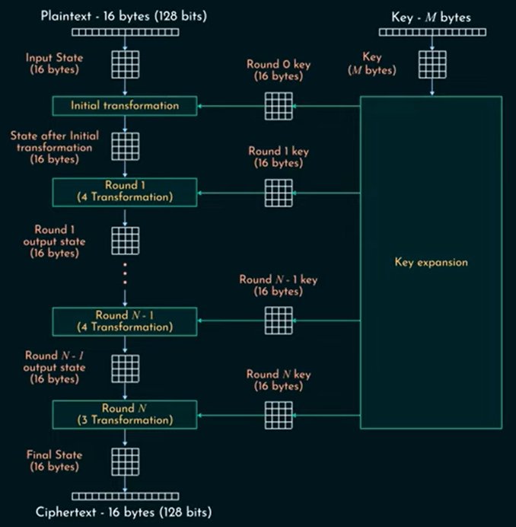
AES
AES (Advanced Encryption Standard) is one of the most widely used symmetric-key encryption algorithms. It’s employed globally for securing sensitive data, including in fields like banking, communication, government, and more.

Slide 10
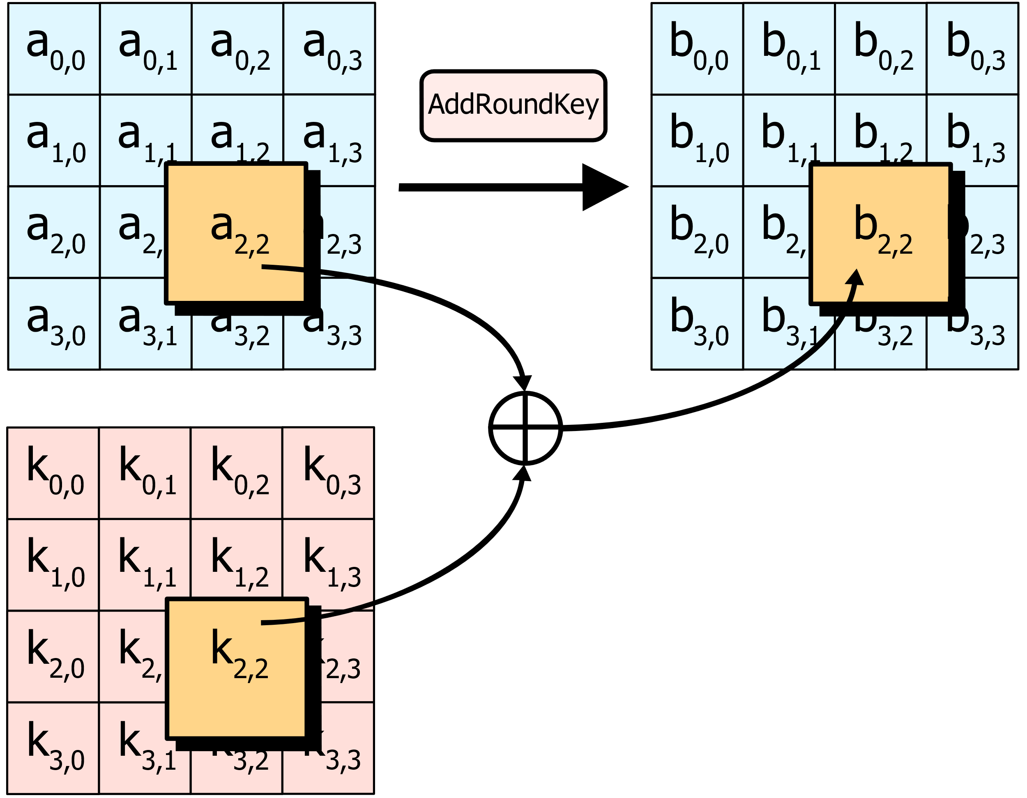
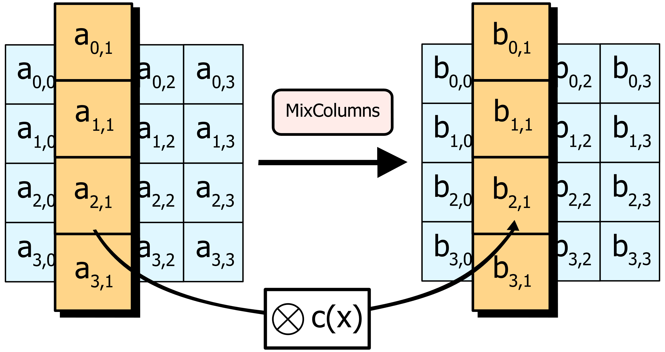
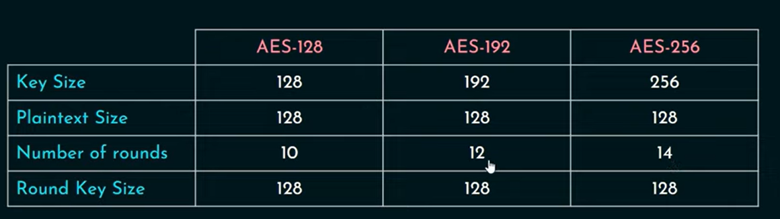
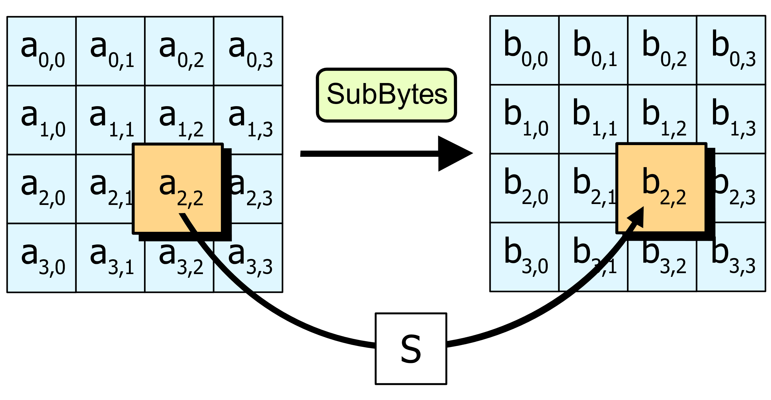
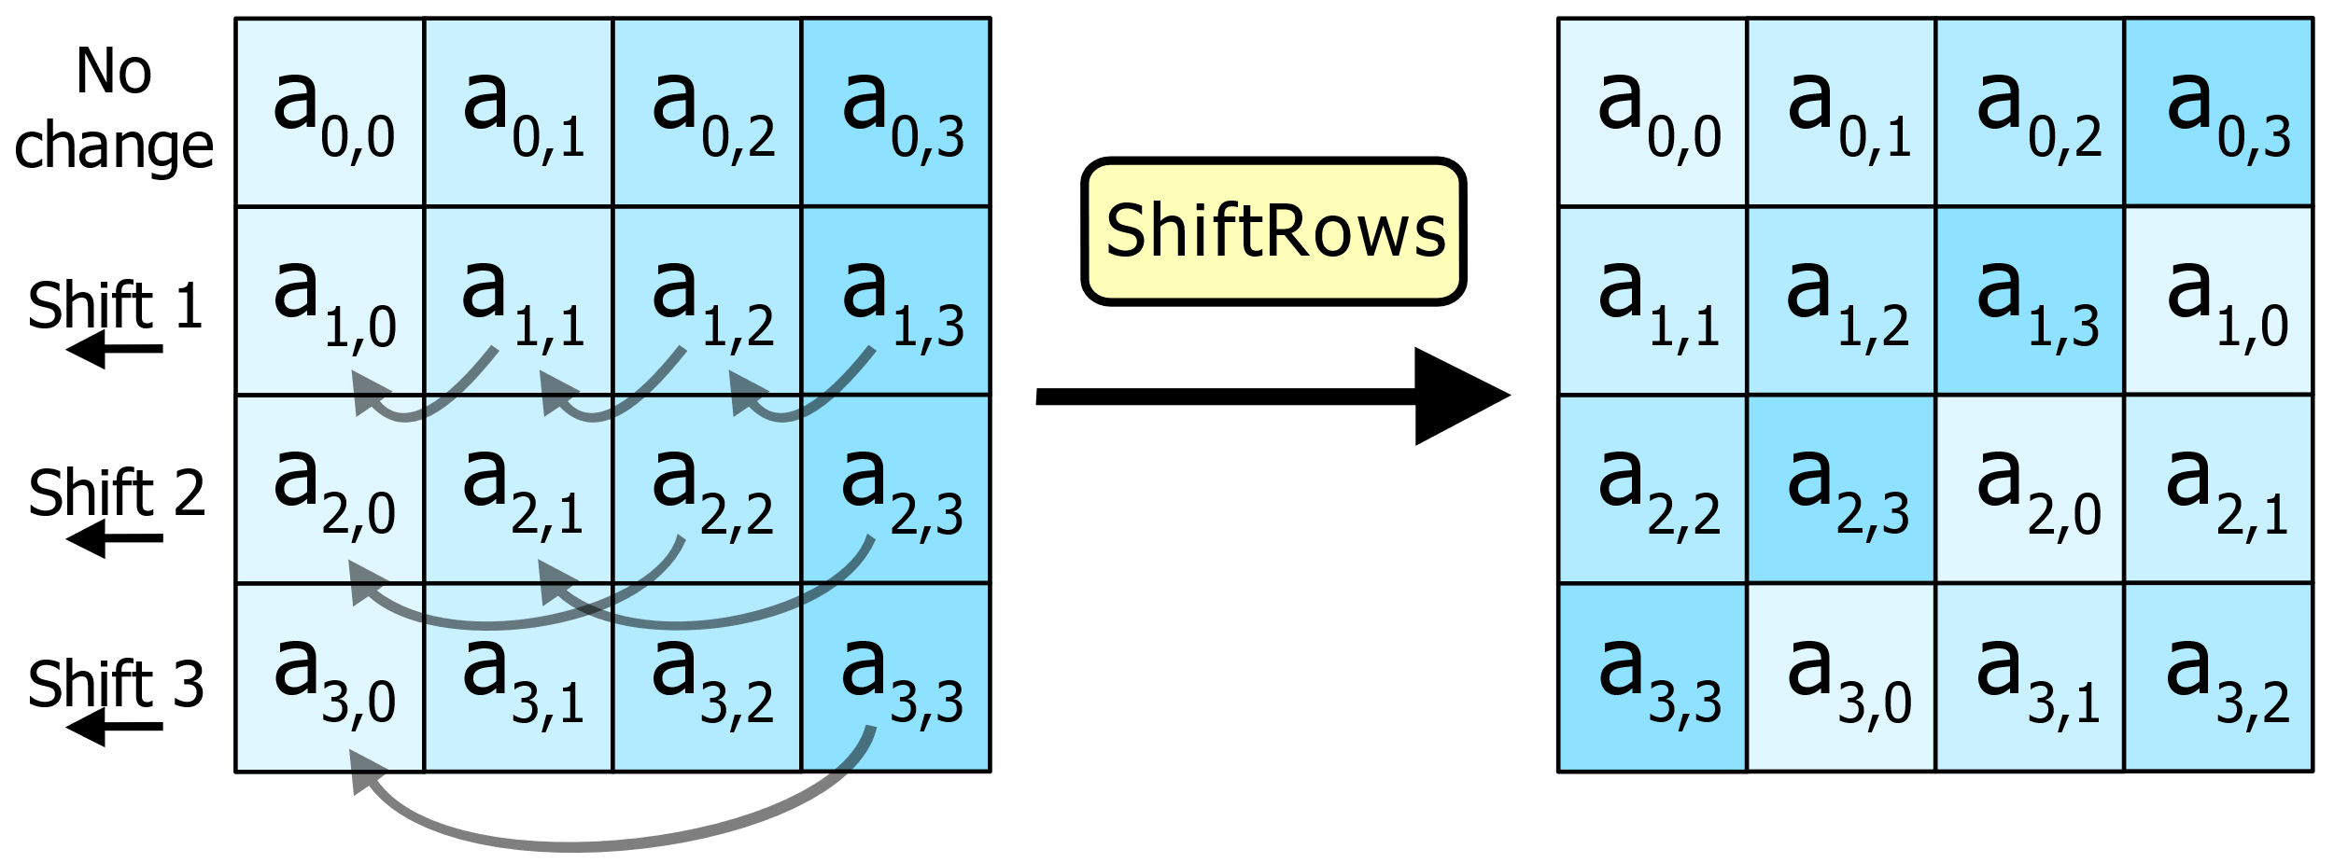
How AES Works?

Slide 11
Which SIM Type Support AES and HKDF
AES:
  3G: Optional
  4G: Supports AES
  5G: Supports AES and It is Mandatory.
HKDF:
  3G: Optional
  4G: Full Support for HKDF
  5G: Full Support for HKDF

Slide 12
CBC vs GCM
AES-CBC (Cipher Block Chaining):
  Performance: Slower compared to GCM due to sequential processing.
  TLS Version Support: Supported in TLS 1.0, 1.1, and 1.2. However, due to security weaknesses, it's being phased out in favor of more secure algorithms like AES-GCM.
AES-GCM (Galois/Counter Mode):
  Performance: Faster than CBC, especially in hardware.
  TLS Version Support: Supported in TLS 1.2 and TLS 1.3. AES-GCM is the preferred mode due to its security and performance benefits.

Slide 13
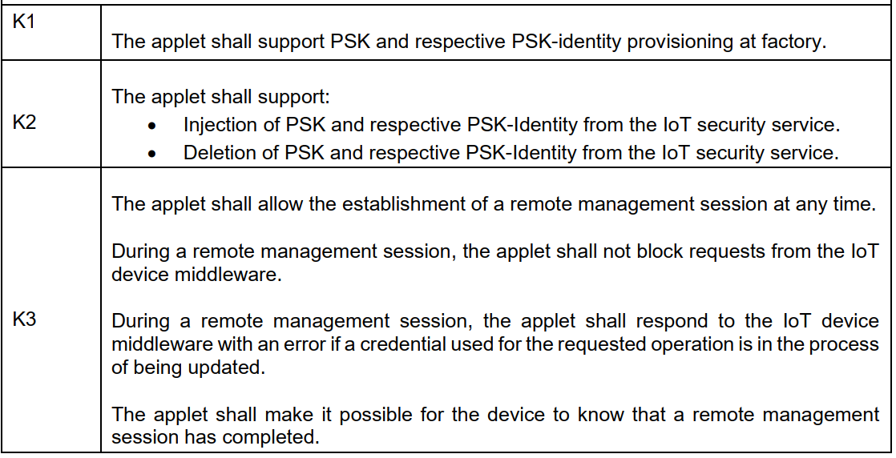
Provisioning and Remote Management by IoT Security Service

